Slide 1
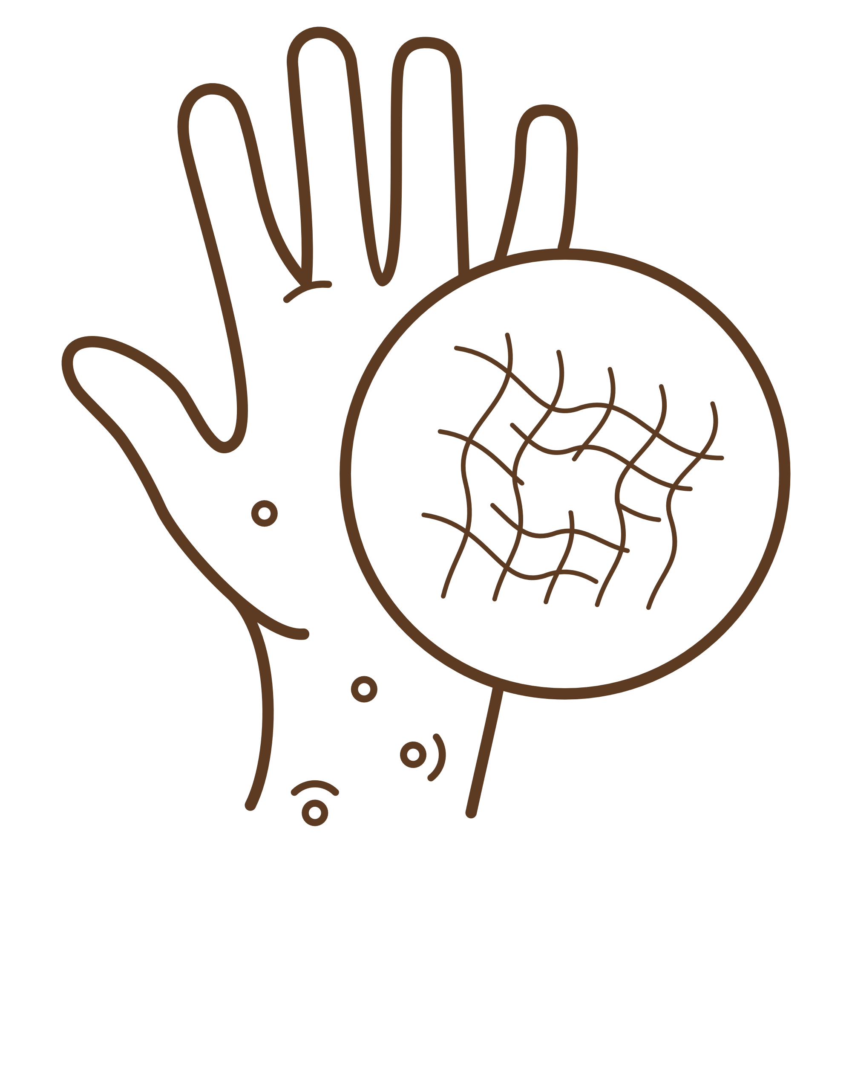
DermaByte
2024

Slide 2
Table of contents
02
03
05
06
04
07
01
Our Team
Introduction
Problem Statement
Functional Requirements
Non-Functional Requirements
Solutions
08
09
Related Work
Ai Model
Future Work
10
11
Technology
Prototype

Slide 3

01
Our Team

Slide 4
Our Team
Name | ID
Seif Tariq Maher | 202000418
Salma Yasser Sayed | 202000395
Maryam Yasser Mahmoud | 202000888
Martina Ibrahim Garas | 202000687
Mariam Salah Sobhy | 202000878
Supervisor
Dr. Helal Ahmed

Slide 5
Table of contents
02
03
05
06
04
07
01
Our Team
Introduction
Problem Statement
Functional Requirements
Non-Functional Requirements
Solutions
08
09
Related Work
Ai Model
Future Work
10
11
Technology
Prototype

Slide 6
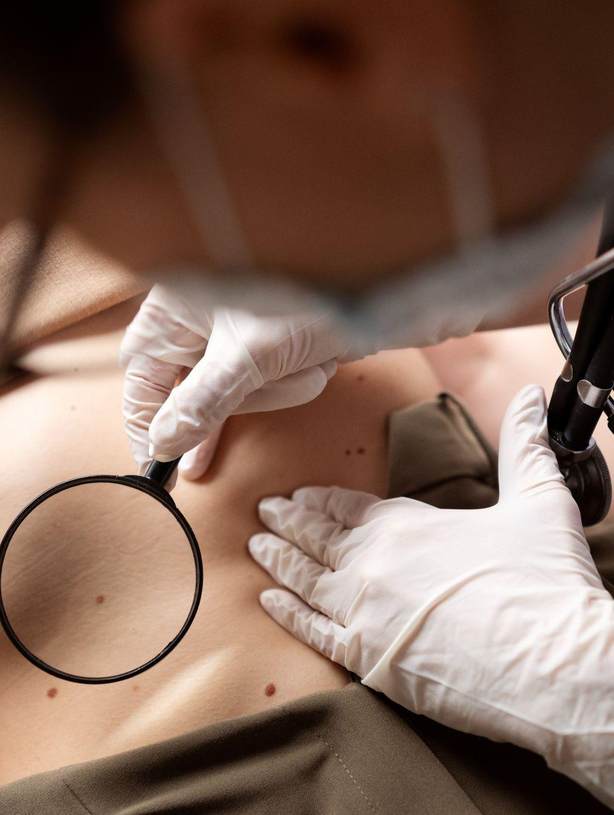
02
Introduction

Slide 7
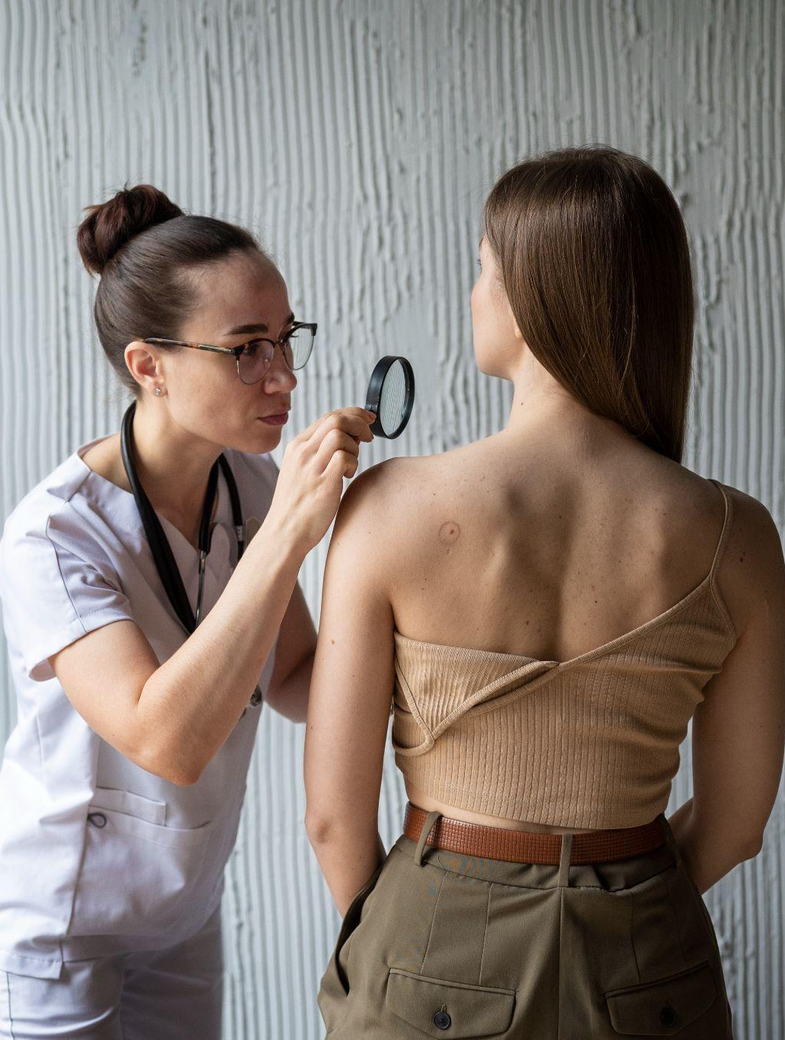
Introduction
DermaByte is a comprehensive healthcare Solutions aimed at improving patient care, early disease detection, and enhancing communication between patients, dermatologists, and laboratories. It consists of four main modules: Automation Diagnosis, Online Consultation, Dermatologists, and Laboratories

Slide 8
Table of contents
02
03
05
06
04
07
01
Our Team
Introduction
Problem Statement
Functional Requirements
Non-Functional Requirements
Solutions
08
09
Related Work
Ai Model
Future Work
10
11
Technology
Prototype

Slide 9
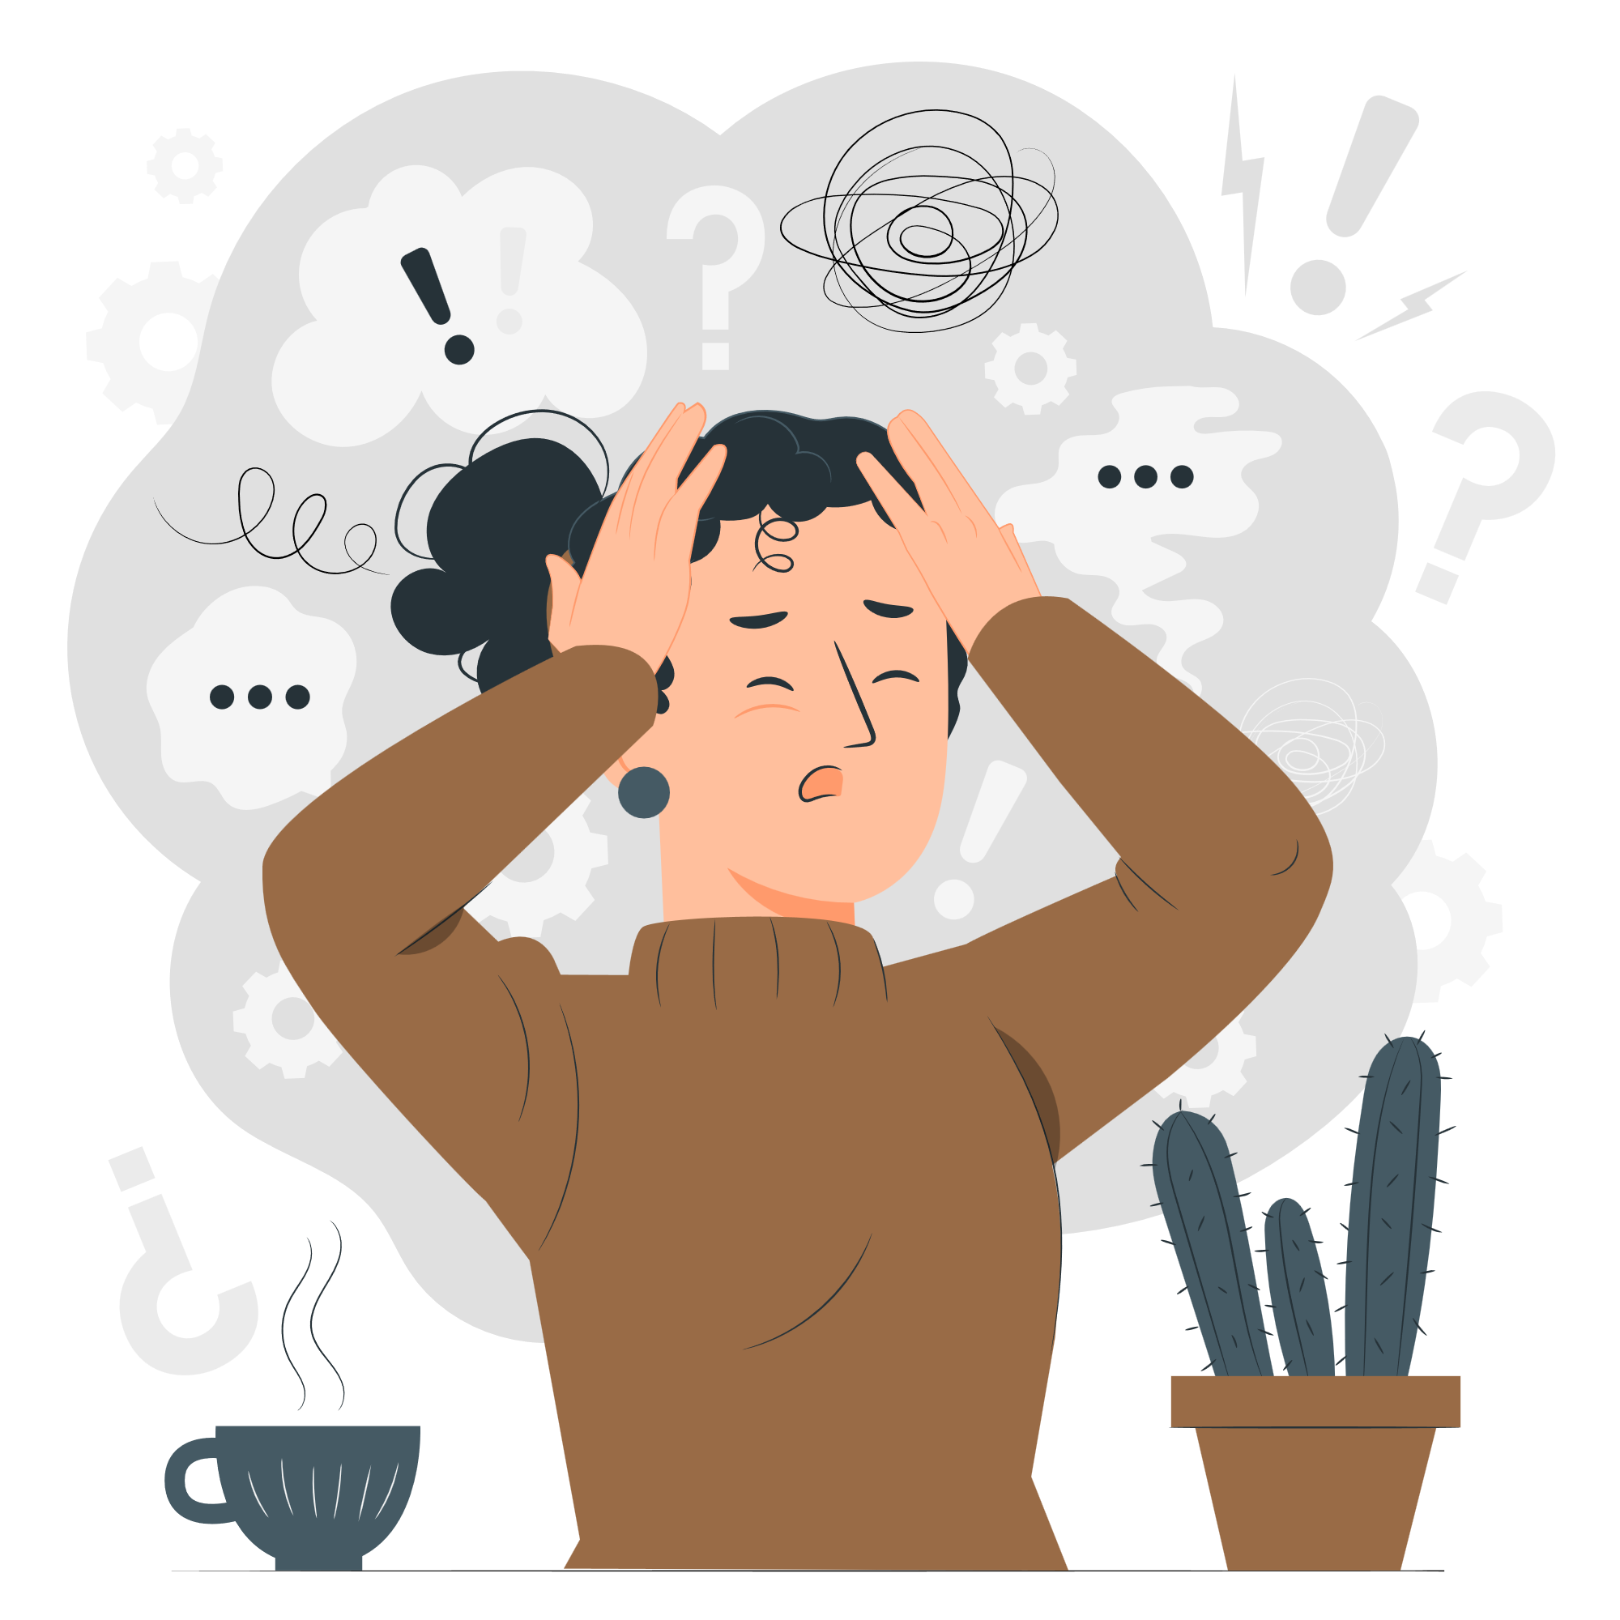
03
Problem Statement

Slide 10
Problem Statement
Inefficiency in Patient Care
Need for an Integrated System
Delays in diagnosis and treatment.
Lack of streamlined processes for patient management
Increased severity of skin conditions due to delayed diagnosis and treatment.
Current systems lack integration, resulting in isolated and inefficient operations.
A unified platform is required to improve overall healthcare delivery and patient satisfaction.
Increased Healthcare Costs
Delays in Diagnosis Process
higher operational costs.
Slow turnaround times for test results.
Limited access to dermatological expertise in remote areas

Slide 11
Table of contents
02
03
05
06
04
07
01
Our Team
Introduction
Problem Statement
Functional Requirements
Non-Functional Requirements
Solutions
08
09
Related Work
Ai Model
Future Work
10
11
Technology
Prototype

Slide 12

04
Solutions

Slide 13
Solutions
DermaByte provides a Solutions through its integrated modules:
Automation Diagnosis: Uses AI to detect skin diseases early.
Online Consultation: Enables patients to consult dermatologists virtually
Dermatologists Module: Assists dermatologists in verifying AI diagnoses and prescribing treatments.
Laboratories Module: Manages and assigns test results to patient reports​

Slide 14
Table of contents
02
03
05
06
04
07
01
Our Team
Introduction
Problem Statement
Functional Requirements
Non-Functional Requirements
Solutions
08
09
Related Work
Ai Model
Future Work
10
11
Technology
Prototype

Slide 15
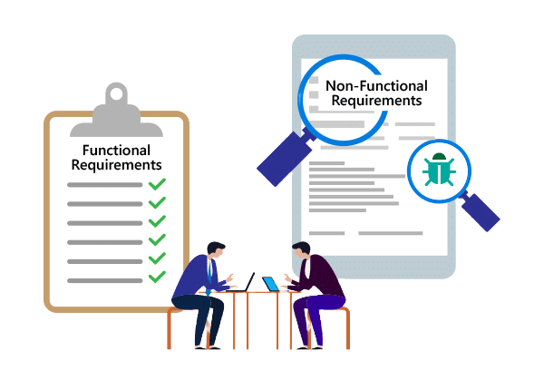
05
Functional Requirements

Slide 16
Functional Requirements
Patient
Account Management: | Sign in / sign up, update profile, sign out.
Health Features: | Access infection prevention advice. Capture/upload photos for AI skin disease detection.
Consultation & Appointments | Search for dermatologists. Book online appointments and pay online . Send reports to dermatologists. View consultations , tests , scans history . Attend scheduled online consultations.
Test Management: | Search and book lab tests, pay online.

Slide 17
Functional Requirements
Dermatologist
Account Management: | Sign in / sign up (with certification upload), update profile, sign out. Set / update schedule and session cost
Patient Interaction: | View patient reports / requests Request tests and update reports. Attend scheduled online consultations.

Slide 18
Functional Requirements
Laboratory
Account Management: | Sign in / sign up, update profile, sign out.
Test Management: | Add/update/delete tests. Search for patient, assign test results.

Slide 19
Functional Requirements
Admin
Account Management: | Sign in, sign out.
Approval & User Management: | Approve/decline dermatologist and lab requests based on certifications. View all registered dermatologists and labs. Delete patients / dermatologists /labs

Slide 20
Table of contents
02
03
05
06
04
07
01
Our Team
Introduction
Problem Statement
Functional Requirements
Non-Functional Requirements
Solutions
08
09
Related Work
Ai Model
Future Work
10
11
Technology
Prototype

Slide 21
06
Non-Functional Requirements

Slide 22
Non-Functional Requirements
Performance:
Scalability:
The system should handle multiple simultaneous users without performance degradation
The system should be able to scale to accommodate growing numbers of users and data​
Usability:
Correctness:
The application should be user-friendly and accessible to all user types.
The app should never allow anyone to edit a profile not intended for that person.

Slide 23
Table of contents
02
03
05
06
04
07
01
Our Team
Introduction
Problem Statement
Functional Requirements
Non-Functional Requirements
Solutions
08
09
Related Work
Ai Model
Future Work
10
11
Technology
Prototype

Slide 24

07
Related Work

Slide 25
Related Work
Features | DermaByte | MiiSkin | MDacne | Eczema Tracker | AAD Chronic Hives Patient | Psoriasis Manager
Provide a report with detailed info about user’s health | ✓ | ✓ | ✗ | ✗ | ✓ | ✓
Help patients find a dermatologist | ✓ | ✓ | ✗ | ✗ | ✓ | ✓
Real-time video and audio capabilities with dermatology | ✓ | ✗ | ✗ | ✗ | ✗ | ✗
Demonstrate historical scans and detections | ✓ | ✓ | ✗ | ✓ | ✓ | ✓
Able to schedule a test using the system's laboratories | ✓ | ✗ | ✗ | ✗ | ✗ | ✗
AI system to identify more than just one skin diseases | ✓ | ✓ | ✓ | ✗ | ✗ | ✗

Slide 26
Table of contents
02
03
05
06
04
07
01
Our Team
Introduction
Problem Statement
Functional Requirements
Non-Functional Requirements
Solutions
08
09
Related Work
Ai Model
Future Work
10
11
Technology
Prototype

Slide 27
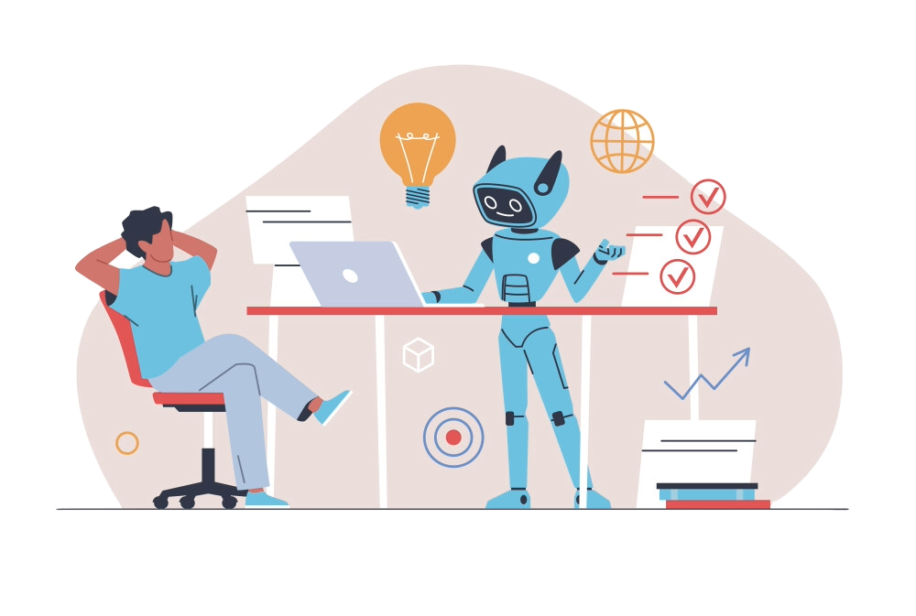
08
Ai Model

Slide 28

8
98%
18 MB
Ai Model
Dieseases
1st Model
Accurace rate
Dataset size

Slide 29
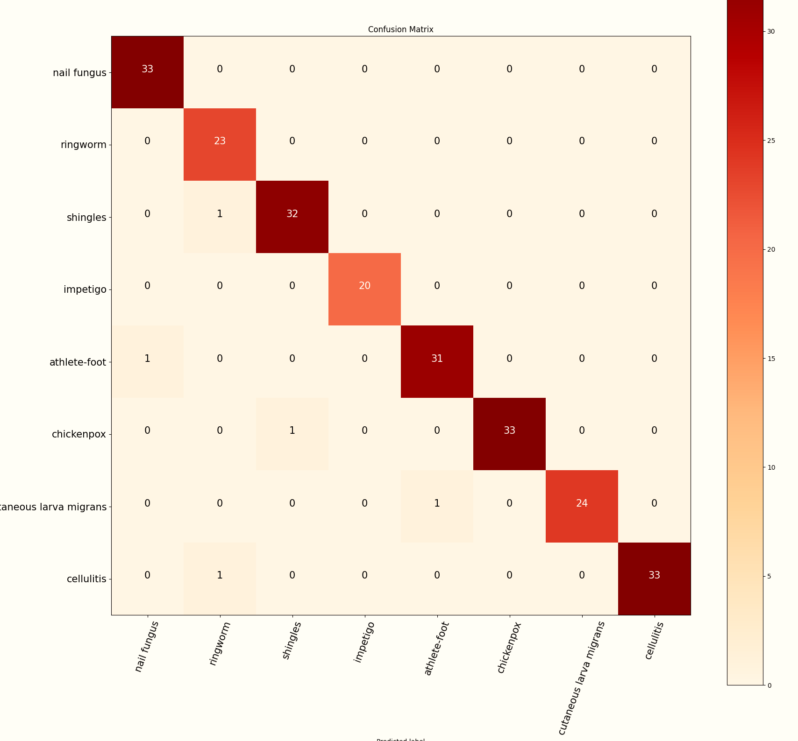
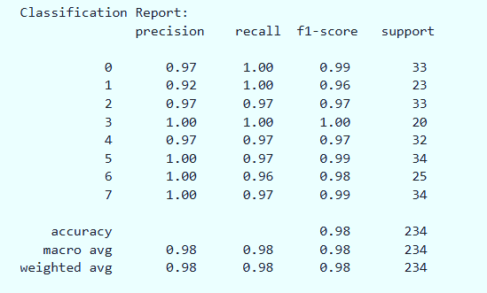
Ai Model

Slide 30
9
87%
6GB
Dieseases
2nd Model
Accurace rate
Dataset size

Slide 31
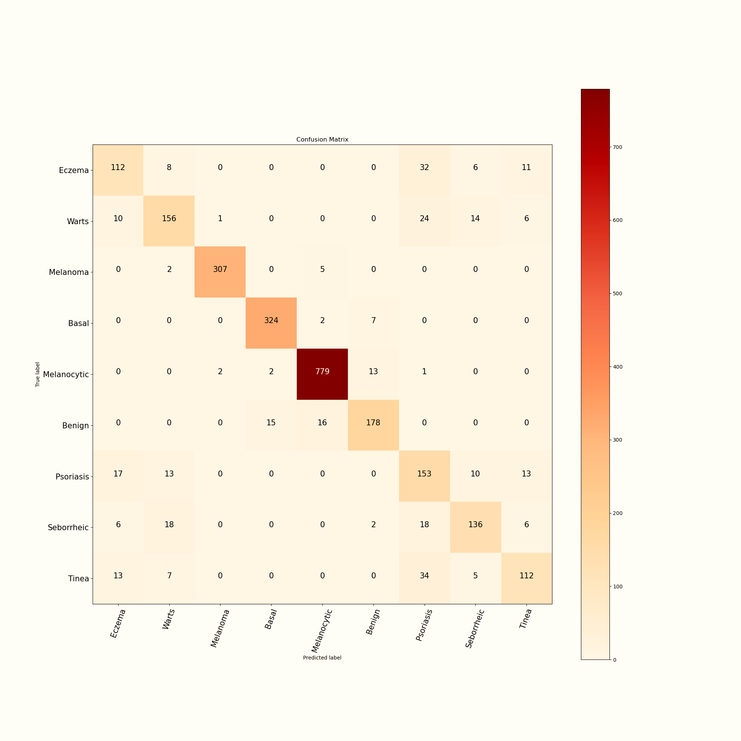
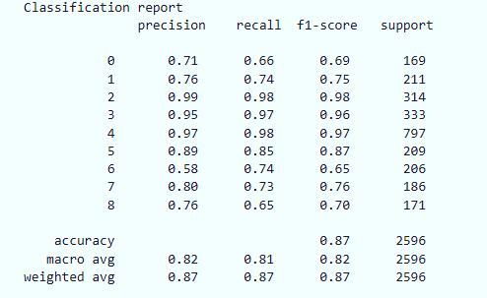
Ai Model

Slide 32
Table of contents
02
03
05
06
04
07
01
Our Team
Introduction
Problem Statement
Functional Requirements
Non-Functional Requirements
Solutions
08
09
Related Work
Ai Model
Future Work
10
11
Technology
Prototype

Slide 33

09
Future Work

Slide 34
Future Work
Expanded Disease Detection
Broaden AI capabilities to detect a wider range of skin conditions with higher accuracy
Home Lab Tests
Introduce home delivery for lab tests, allowing patients to perform diagnostics from home for increased accessibility and privacy.
Exclusive Discounts
Doctors can access and distribute special discount coupons for various lab tests.

Slide 35
Future Work
Health Monitoring Tools
Incorporate tools for tracking skin conditions with automated alerts for proactive health management.
Multilingual Support:
Add multilingual capabilities, including Arabic, to enhance accessibility for diverse populations.
Educational Resources:
Provide a comprehensive library of educational resources, including articles, videos, and infographics, to empower users with knowledge about various skin conditions, treatment options, preventive measures, and skincare tips.

Slide 36
Table of contents
02
03
05
06
04
07
01
Our Team
Introduction
Problem Statement
Functional Requirements
Non-Functional Requirements
Solutions
08
09
Related Work
Ai Model
Future Work
10
11
Technology
Prototype

Slide 37
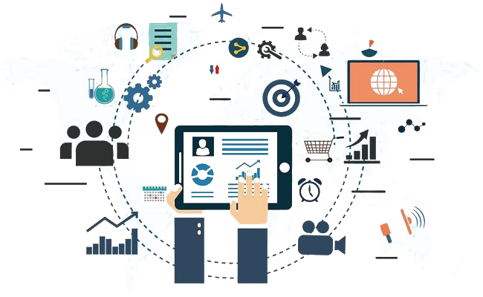
10
Technology

Slide 38
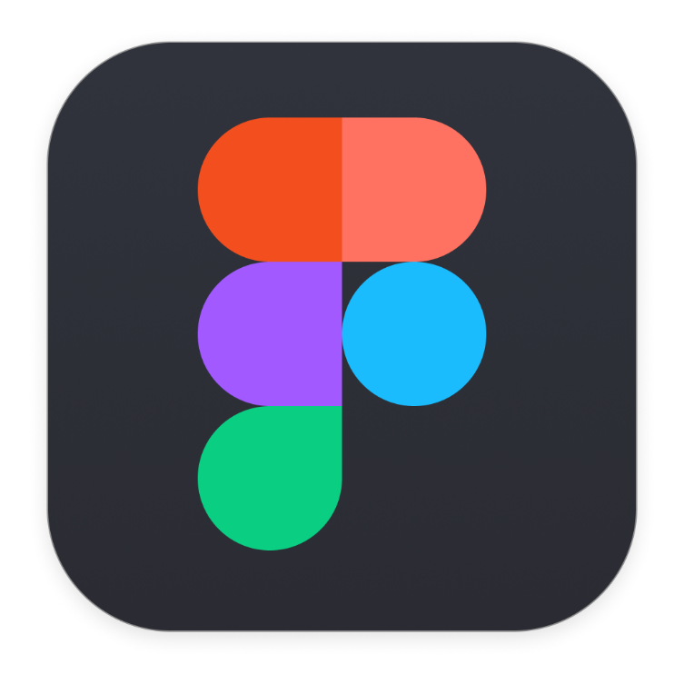






Technology
Figma For Designs and Prototype
Flutter Using Dart programming language
VS Code IDE
GitHub Version control
NodeJS for implement backend
MongoDB for storing data
Postman for testing APIs

Slide 39
Table of contents
02
03
05
06
04
07
01
Our Team
Introduction
Problem Statement
Functional Requirements
Non-Functional Requirements
Solutions
08
09
Related Work
Ai Model
Future Work
10
11
Technology
Prototype

Slide 40

11
Prototype

Slide 41
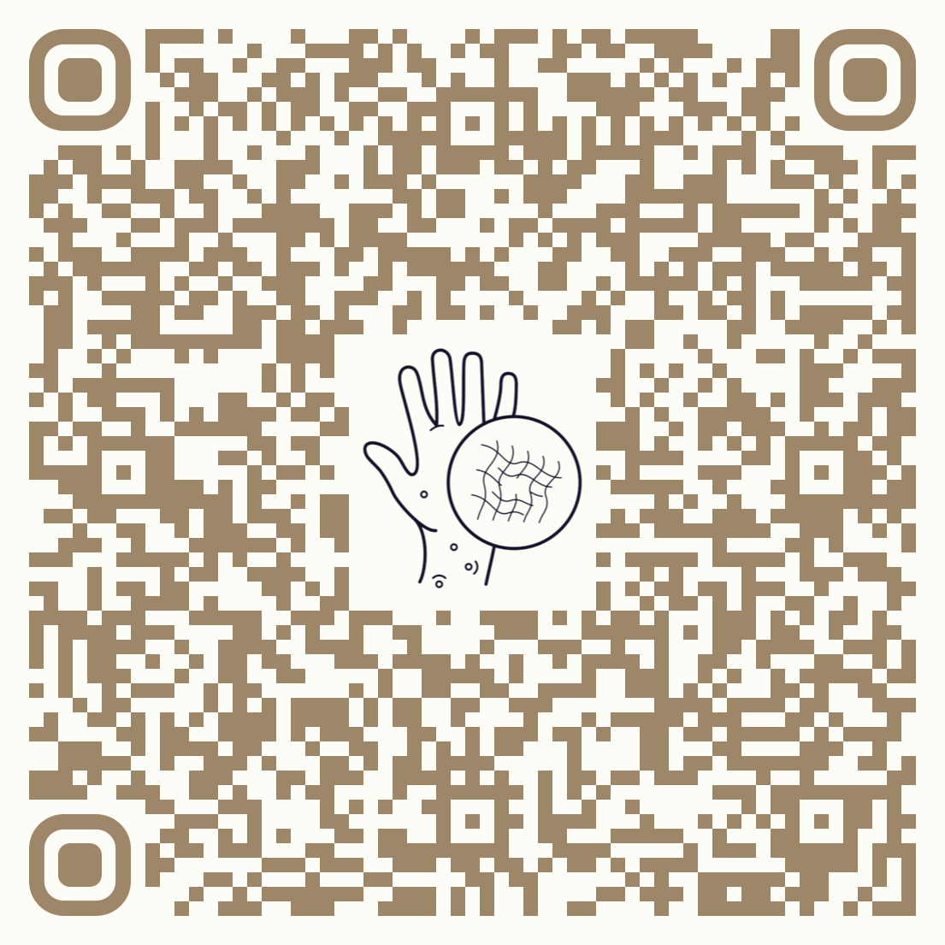
Prototype
You can scan this code for live demo

Slide 42

Thanks For your Time
Connect with us.
dermabyte2024@gmail.com

